Slide 1


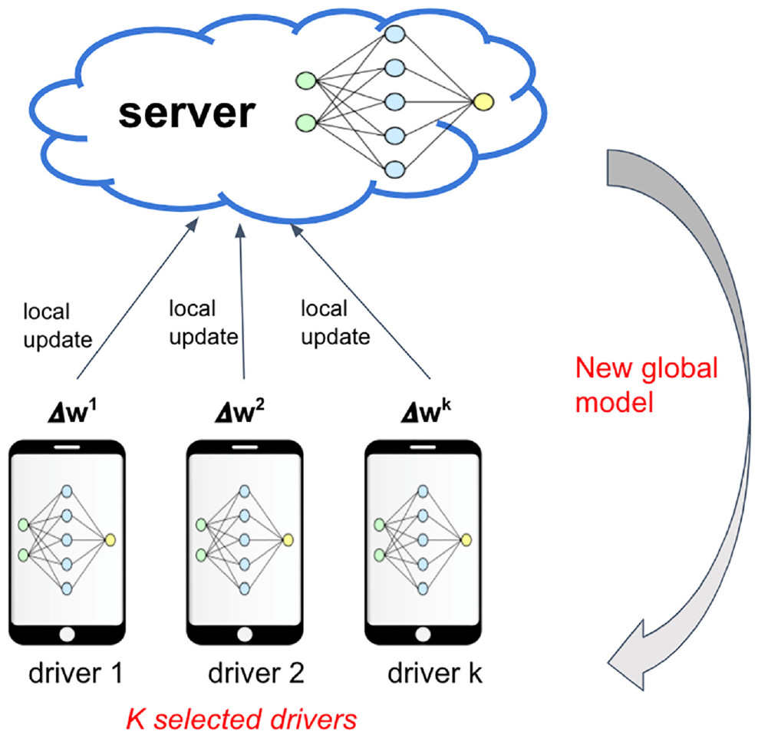
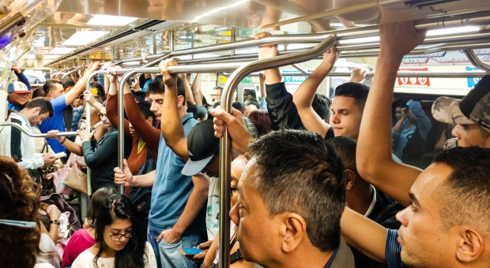

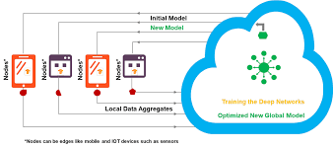
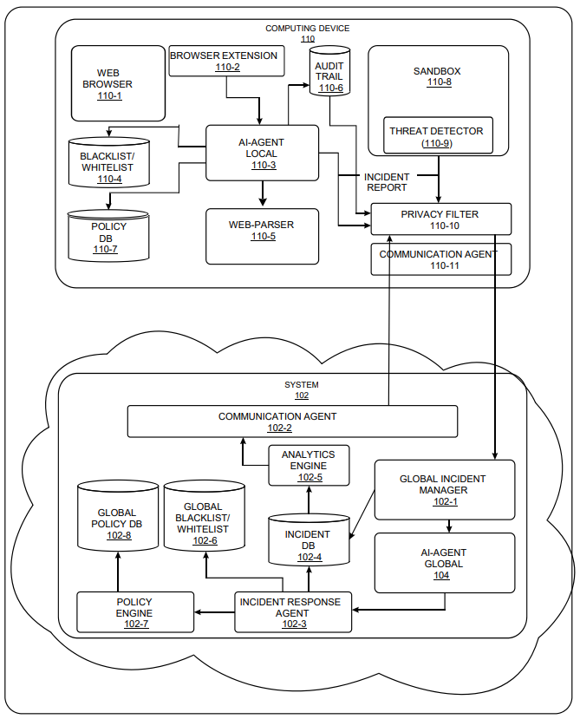
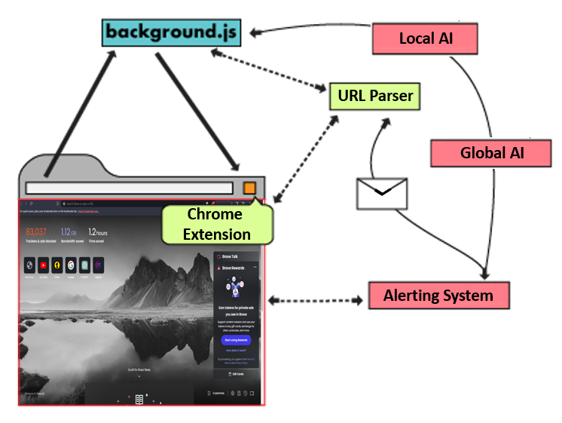
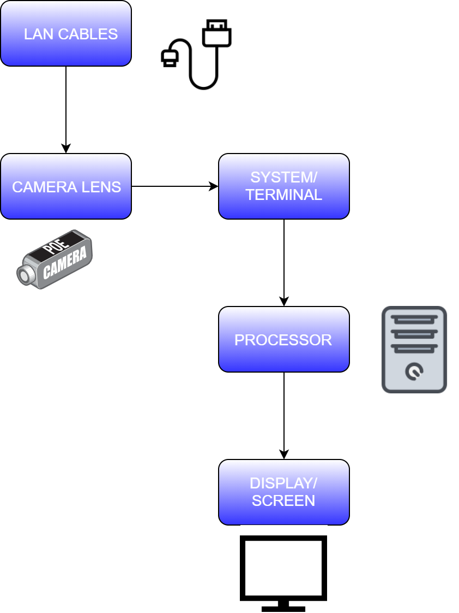

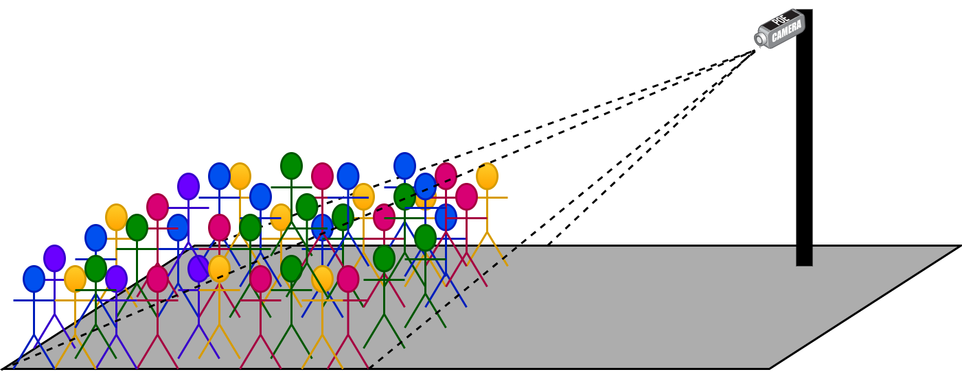
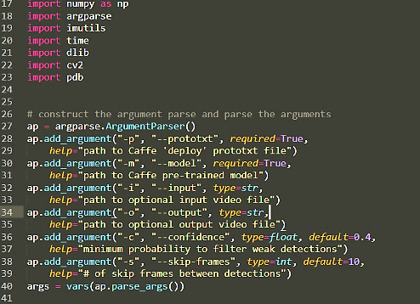
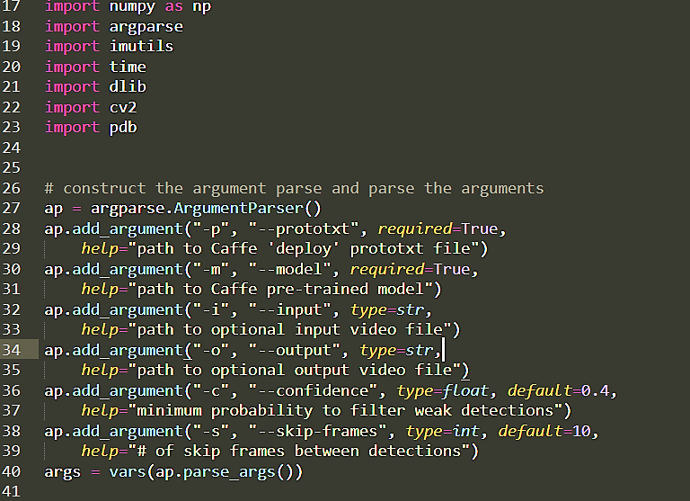


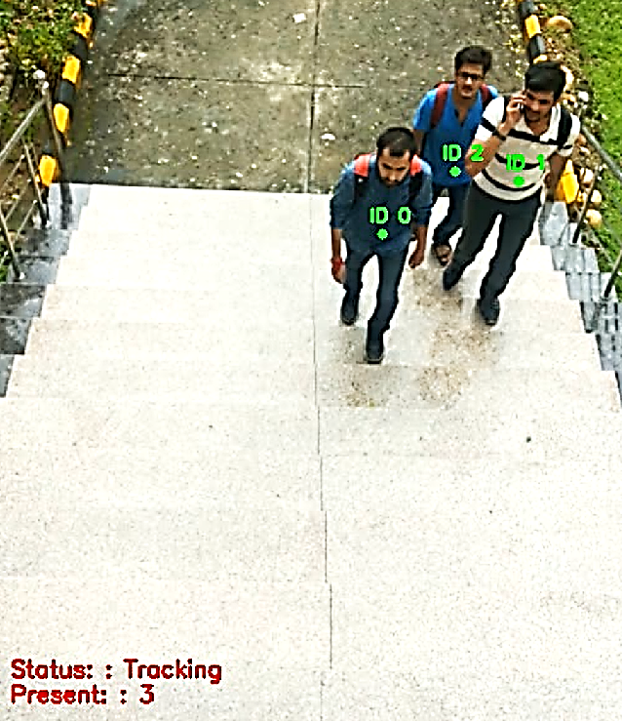
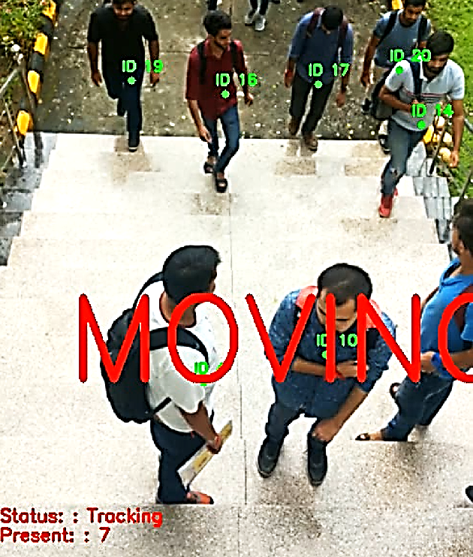
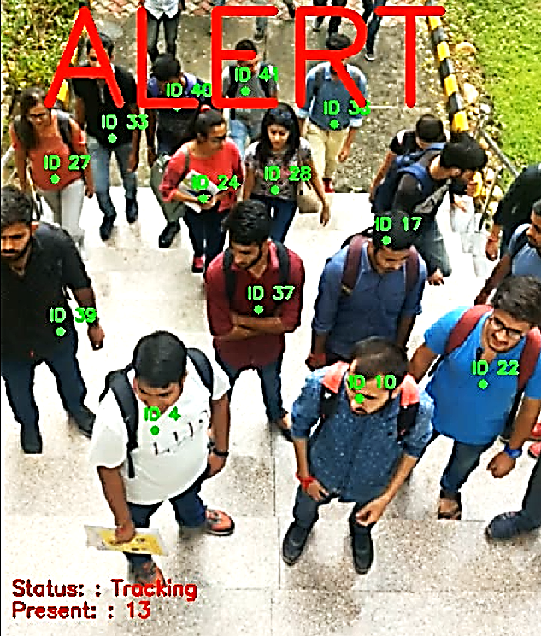

CYBER HYGIENE TOOL
AADHAAR KOUL
EMAIL: 2020a1r040@mietjammu.in
PHONE: +91 6005846156
Abstract
Data Processing Workflow
PROPOSED SOLUTION
To address the problem of the lack of cyber hygiene awareness among Indian internet users and the increasing risks associated with online activities, we have developed a comprehensive solution called KAVACH. KAVACH is an AI-based advisory tool that provides users with a one-stop solution to safeguard their online activities. It keeps track of all online activities and provides real-time alerts and suggestions to users, enabling them to make informed decisions about their online behavior.KAVACH uses federated learning models to improve its algorithms continuously. By utilizing deep neural networks, it identifies complex types of attacks and classifies them for the users, ensuring a safer online experience.Moreover, to ensure users' privacy and security, KAVACH uses a sandboxing agent that tests the product before deploying it onto users' devices.KAVACH is designed to meet the needs of users of all skill levels, making it easy for anyone to use it. With KAVACH, we believe we can make a significant impact in promoting cyber hygiene awareness among Indian internet users and keep them safe online.
REQUESTED URL
URL PARSER
DATA CLASSIFICATION
AI MODEL TRAINING
Each feature map is
divided into cells with anchor boxes.
Each anchor box predicts offsets, additional fields, and class probabilities.
GLOBAL MODEL TRAINING
Innovation & Impact
INITIATE ALERTING SYSTEM
INNOVATION:
* AI based agent deeply classifies the web urls and classifies them for further processing.
* An advisory/recommendation system for the genuine web portal / sources for downloading commonly-used software/content.
* Sandboxed Environment to check for malformed or malicious data propogation.
* A global Artificial intelligent Federated Learning based model that updates each and every product distribution with an attack incident.
* A Black list and a while list is maintained globally in order to safeguard every other user from any type of attack.
IMPACT:
* An artificial intelligent based advisory service to the users to help them avoid potentially dangerous web sources.
* A globally coordinated dynamic federated learning framework which continuously fine tunes its response to globally observed threats.
* A feedback mechanism which helps improve accuracy and effectiveness of the advisories , issued by the AI based agent on individual computers , against new emerging threats.
* A multidimensional framework protecting user against a multitude of online frauds and threats.
SECURITY PROTOCOLS IMPLEMENTED
Functional Workflow
Architecture Diagram
Front end
Back end
CAMERA LENS
Surveillance Officer
Video feed obtained is converted to frames and then processed at a given speed called frames per second.
FEED INPUT
LAN CABLES
AI NEURAL MODEL
CROWD DETECTION
SYSTEM CORE
SYSTEM / TERMINAL
Motion and Density Alert Generated on Display
ALERT
PROCESSOR
Interaction Model
START
DISPLAY SCREEN
BROWSER
USER REQUEST
PERFORMANCE CHARTS
URL PARSING
DATA CONTAINER
GLOBAL AI
LOCAL AI
Language(s) | Technology Stack
MODEL TRAINING
BLACKLIST FILTERING
LANGUAGES:
PYTHON , JAVASCRIPT , JQUERY , HTML , CSS
TECHNOLOGY STACK:
WEB DEVELOPMENT , CLOUD COMPUTING
ARTIFICIAL INTELLIGENCE
CYBER SECURITY
API(S):
Urllib.parse
SANDBOXING
Live Data Synchronization
USER
Project Code: - CSE_P15

